Slide 1


Final Project by: Zvi Amosi and Alexey Serdtse
Big Data Engineering

Slide 2


Authors
Zvi Amosi
BI Developer and Analyst Ayalon Insurance Company Ltd.
Alexey Serdtse
ETL Developer Naya Technologies (Nice Ltd.)

Slide 3
A large retail network is required to publish product prices within an hour of updates.
The published data includes: prices, promotions, chain name, branch, date, and time.
At the end of each day, the data is deleted, and no historical record is kept.
Currently, at least two apps utilize this data.
No one tracks or displays historical changes over time.
Background

Slide 4
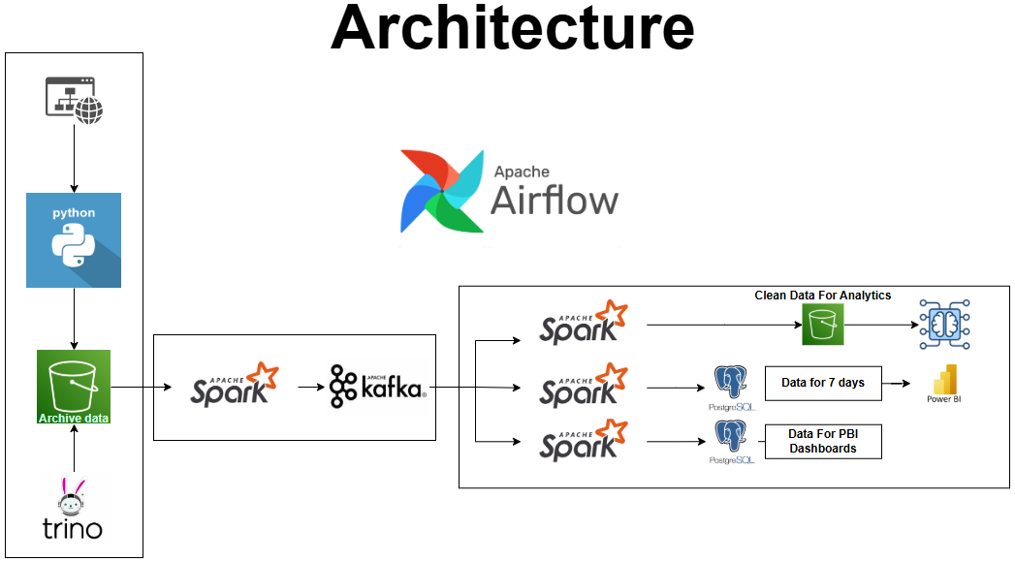

Slide 5
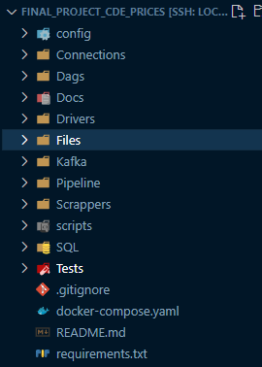
Project Structure
Configuration file – Configuration files that hold connection params: secrets/access keys, bootstrap servers, and other environment-specific configurations.
Connections – Reusable functions and utilities for establishing connections to external services i.e. databases, buckets etc.
DAGS - Definitions for orchestrating workflows.
Drivers - Drivers required for interacting with external tools.
Pipeline – The core pipeline logic for processing, transforming, and loading data.
Scrapper - Script for web scraping and extracting data from external website.
Tests – Testing validity and existence of components required to correct run of code.
Requirements - Lists Python dependencies required for the project, which can be installed using “pip install –r “
Kafka – include files tracking Kafka’s offsets for each producer.

Slide 6
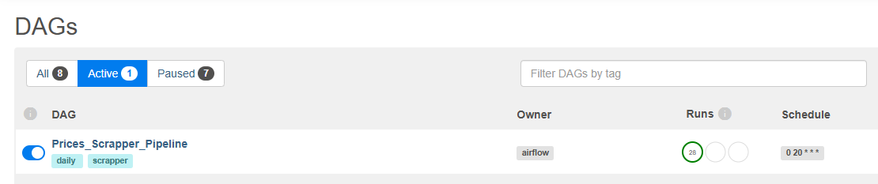
Central DAG
Prices_Scrapper_Pipeline: runs daily in 10 PM (UTC)

Slide 7
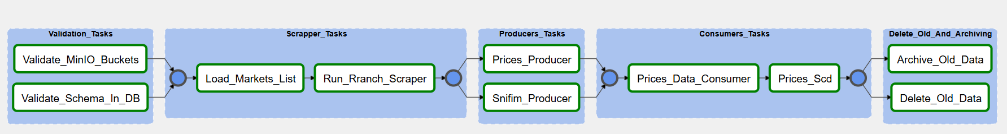
DAG’s expand
Validation Tasks:
Verify that all mandatory buckets required for the pipeline exist and are available (using the MinIO Client).
Ensure that all mandatory tables for the pipeline exist and are available (using SQLAlchemy Inspect).
Consumer Tasks:
Processes Kafka messages, enriches and cleans the data using Spark. Stores results in PostgreSQL and MinIO.
Scrapper tasks
Load list of markets with access credential to access data from source system.
Automates the extraction, parsing, and storage of XML data files from a secured website into MinIO storage.
Delete and Archiving:
Archives and deletes files older than a specified threshold (7 days) in a MinIO bucket
Deletes outdated data from a PostgreSQL table based on a defined threshold

Slide 8
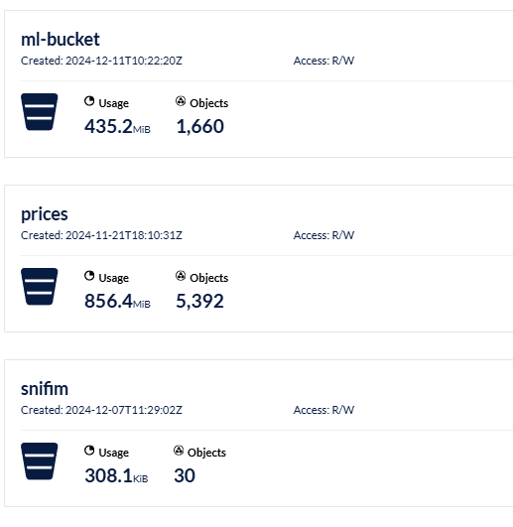
List of Buckets

Slide 9
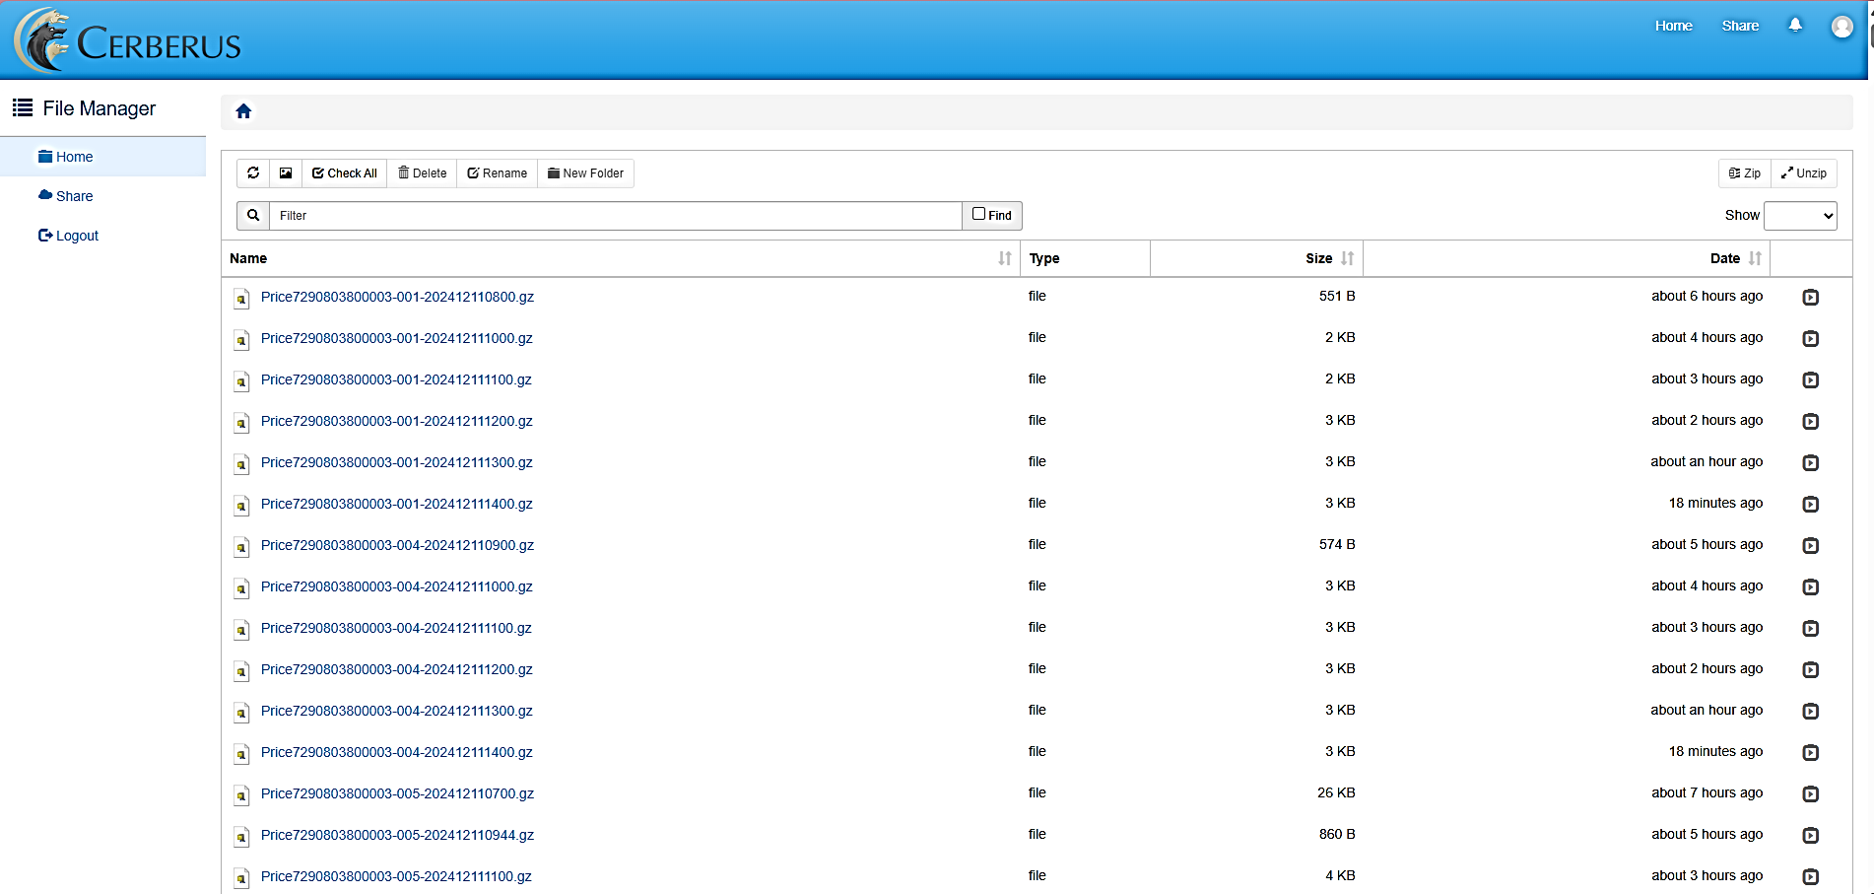
Source Of Data
URL: https://url.publishedprices.co.il/file/d/ Username: yohananof

Slide 10
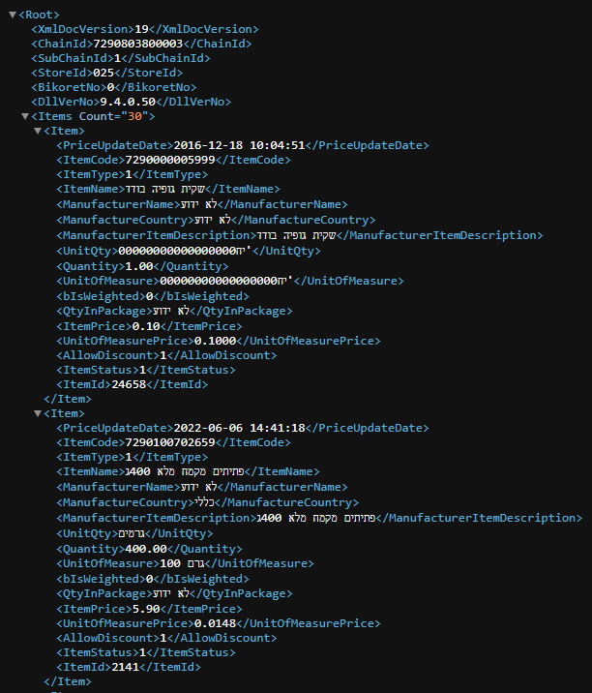
Source Of Data
XML File inside every zip file

Slide 11
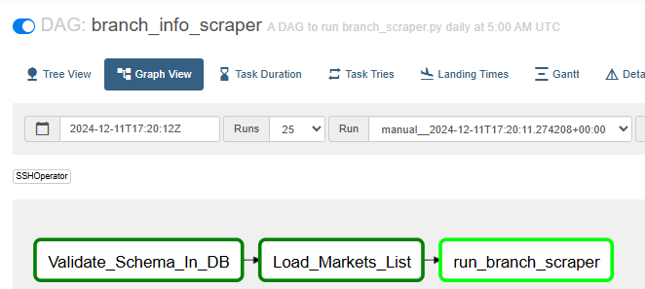
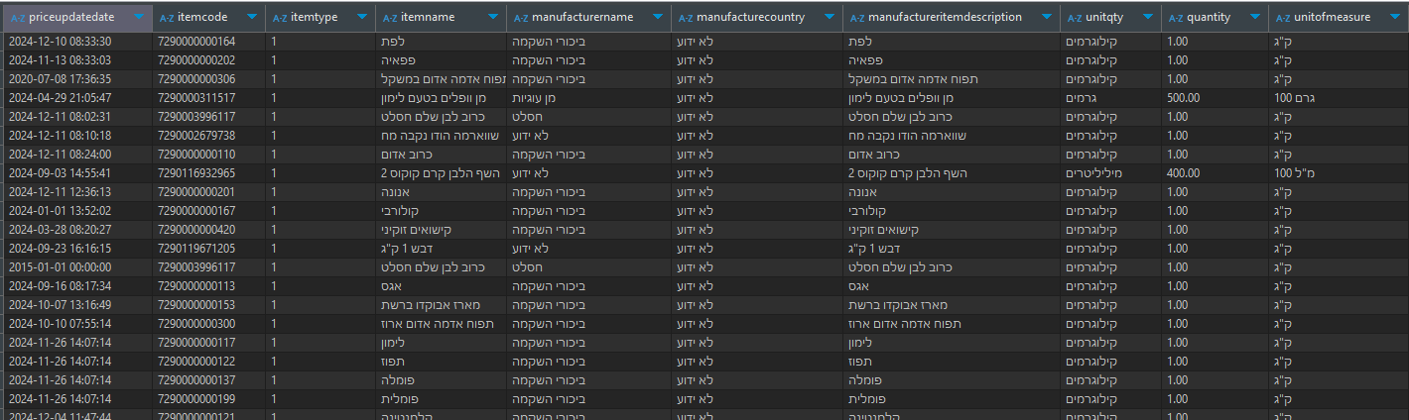
Import Data To Archive Buckets
Scraping Mechanism:
A scrapper iterates over all providers and branch daily data. Using BS4, Selenium and Chrome web driver.
Extracts pricing data and stores it in a “prices” bucket. Only new files!
Data Format:
Data is saved in Parquet files with Snappy compression for efficient storage and retrieval.
Orchestration:
Automated with Airflow, ensuring a scheduled daily run.

Slide 12
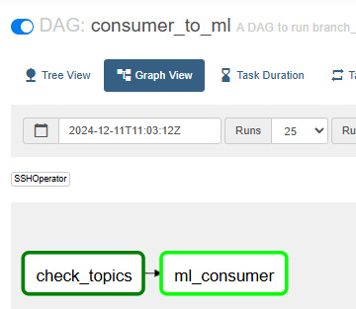
Pipeline – 1: Prepare data for ML
Read streams of “Prices” and “Snifim” and gets data from “Reshatot”.
Enrich dataset by broadcast join between the datasets
Filters for specific columns from both datasets.
Ensure clean data:
“itemcode” is not null.
“last_update_date” is not null
Add columns:
“days_since_last_price_update”
“is_price_update_stale”
“snapshot”
“snapshot_month”
“snapshot_quarter”
“is_weekend”
Snifim description columns
Ensure both topics exists in kafka
Read new data only

Slide 13
Pipeline – 4: Zip all files older than 7 days
Steps:
Identify Buckets: Focus on "prices" and "snifim" buckets.
File Age Check: Locate files older than 7 days.
Archive Old Files: Move identified files into a zip archive for compression.
Outcome: Minimize storage usage and reduce costs.

Slide 14

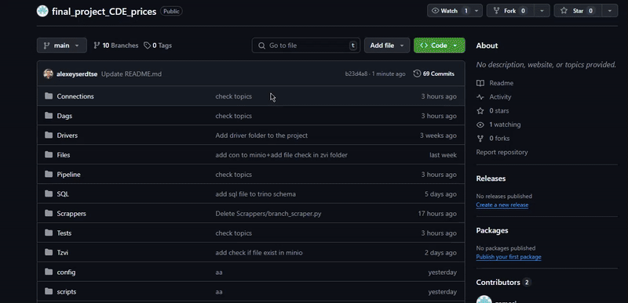

Github Repository
Link to repository: https://github.com/zamosi/final_project_CDE_prices

Slide 15


